Slide 1
Automation the Easy Way With XDR Automation
LAB Supplement Deck
Shaun Roberts
Distinguished Engineer.CX, @LordAutomation
Mohammed Hamzeh
Principal Engineer.CX, @Moh_27903
Session ID: LABATO-1000

Slide 2
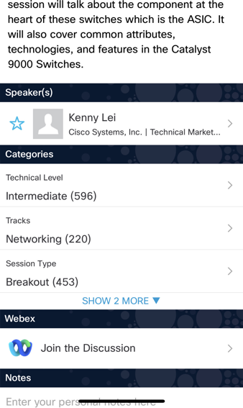
Cisco Webex App
Questions?
Use Cisco Webex App to chat with the speaker after the session
How
1
Find this session in the Cisco Live Mobile App
Click “Join the Discussion”
Install the Webex App or go directly to the Webex space
Enter messages/questions in the Webex space
2
3
4
Enter your personal notes here
Webex spaces will be moderated by the speaker until June 13, 2025.
https://ciscolive.ciscoevents.com/ ciscolivebot/#LABATO-1000

Slide 3
Agenda
01
XDR Automation
02
XDR Automation Components
03
Basic Workflow Lab
04
Best Practices
05
Further Resources
06
Conclusion

Slide 4
The Days gains….
What you should learn by days end
How to Use XDR Automation
How to make Great Use of Workflow Automation
What we want you to take from today
Excitement for Orchestration
Knowledge that Automation can be easy!

Slide 5
XDR Automation

Slide 6
XDR Automation
What?
Cross Domain, Technology Agnostic Orchestration Platform
Why?
Rich integration with APIs, CLIs, and other applications
Runtime environment integrated with Devtime
How?
Operated on a SaaS Platform
Simplistic coding increases speed and efficiency
Micro-Services Architecture
Drag and Drop coding
Ability to develop workflows and integrations to fit any need
Formally known as Cisco Action Orchestrator(AO) or SecureX Orchestration(SXO)
Low-To-No code graphical environment

Slide 7
General Use Cases
Multi Domain Integration
Parse data from a website and insert it into a database or publish it via API
Connect multiple Cisco products for monitoring and reporting
End To End Orchestration
Take in configuration from an end user and apply it to many devices and report on it
Parse emails for information, turn those into Support Cases and keep a sync between two unique systems
Monitoring and Reporting
Query systems via API for statistics and publish those to Databases and Graphics Utilities
Watch the health of certain components and heal those components when issues arise
Robotic Process Automation
Reading emails and case notes, then determining proper business actions to take as a result of that information
Collecting and digesting large amounts of data and then making corrections, notifications, and enhancements to the data based on business rules

Slide 8
XDR Automation Remote Execution
Allows remote execution and connectivity from public cloud based XDR into on prem systems
Useful to connect to customers’ internal devices, APIs, clouds, and more
Fully secure connection between public and private clouds creating a full Hybrid Cloud Model
Web Services and Terminal Adapters
Deployable inside customer environment
VMWare OVA
XDR
Remote Execution Appliance
Customer Datacenter
Notes:
Modify workflows to add Notification component – Webex Teams, email notification

Slide 9
Development Stack
Persistence: MongoDB
Security: Crypto Service
Messaging: Kafka
Logs: DataDog
Operations Monitoring: Datadog
Core Backend: Golang
Adapters Development: Go, Java, Python
DSL : JSON
UI development: ReactJS
Management Platform: Docker + K8S (EKS)
XDR Cloud: AWS
CICD: Jenkins

Slide 10
XDR Automation Components

Slide 11
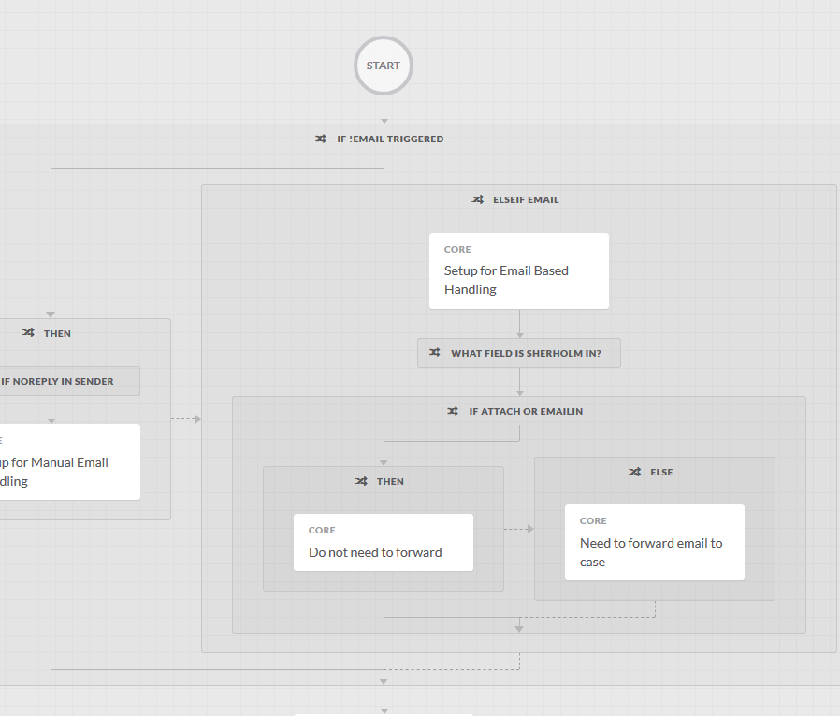
Basic Concepts
Workflow: Sequence of activities or actions
Activity: Can be a REST call, Run Terminal, Send Email etc., It is the lowest “level” in Automation and is a call to do some action against some endpoint or component
Adapter: Adapter is like an Interface, it defines one or more Activities that can be run to achieve a particular outcome
Target Type: Identifies the type of Targets that can be defined and used by Activities
Targets: Identifies the host/endpoint that an action or workflow will use when executing
Runtime User Type: Identifies the type of Runtime Users (Account Keys) that can be used by Targets
Runtime Users: Defined set of user credentials, e.g. userid and password, that will be used to login into one or more Targets. Also called Account Keys

Slide 12
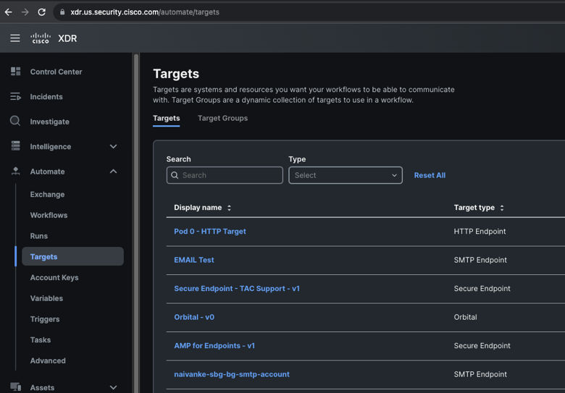
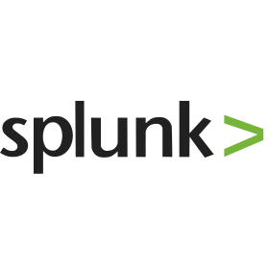
Targets
Component automation is executed against
Example Targets: AWS, Git, Google Cloud Endpoint, HTTP Endpoint, IMAP, JDBC Database, Meraki, Microsoft Windows, POP3, Prime Services Catalog, SMTP, Terminal Endpoint, Terraform, Unix/Linux, ACI, AppDynamics, Azure, DNA Center, Kubernetes, NSO, OpenShift, ServiceNow, UCSD, Vmware, and many more!
Compiled vs “Atomic” Adapters
Connection information varies per connection
Runtime User or Account Keys give access and authority for target
Target Groups – Allow execution of automations against groups of targets based on target type. Can also add individual targets into group

Slide 13
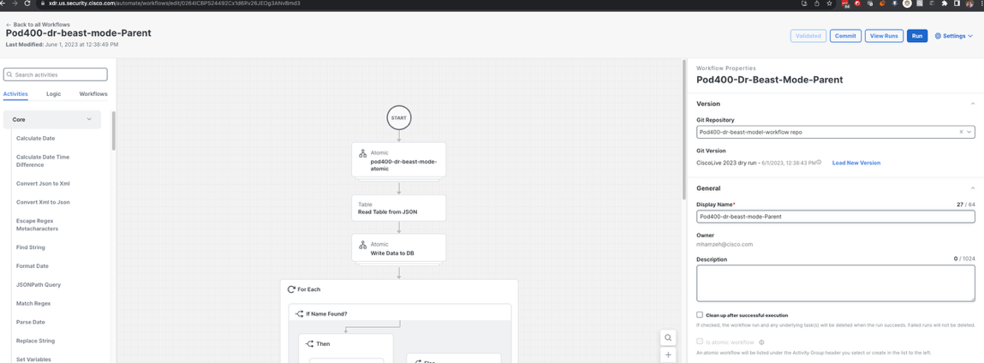
Workflows
A setup of actions or activities including some flow control which becomes an automation
Can be large scale like a program or small scale like a single function
Contains variables of both local and global scope
Activities or actions are dragged and dropped into the Workflow canvas for execution
Atomic Workflows – act like activities in UI but are workflows.
Workflow Editor components
Toolbox
Painter/Canvas
Properties
Properties
Canvas
Toolbox

Slide 14
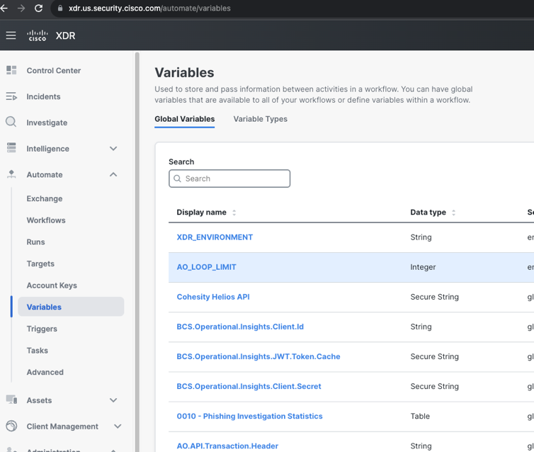
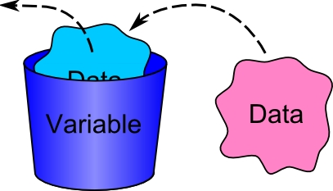
Variables - scopes
Scopes
Global – Accessible Anywhere
Environment – Settings for system
Workflow – Part of workflow only
Local – value destroy after runtime
Input – Inputs to the process
Outputs – outputs from the process
Static – like local but value retained

Slide 15
Variables - Types
Basic
Boolean – True/False
DateTime – Time and Date
Decimal – Floating point number
Integer – Whole numbers
Secure String – String encrypted in the database and UI
String – array of characters
Advanced
Tables – Multi-dimensional array
Self Defined – Objects of Table Types

Slide 16
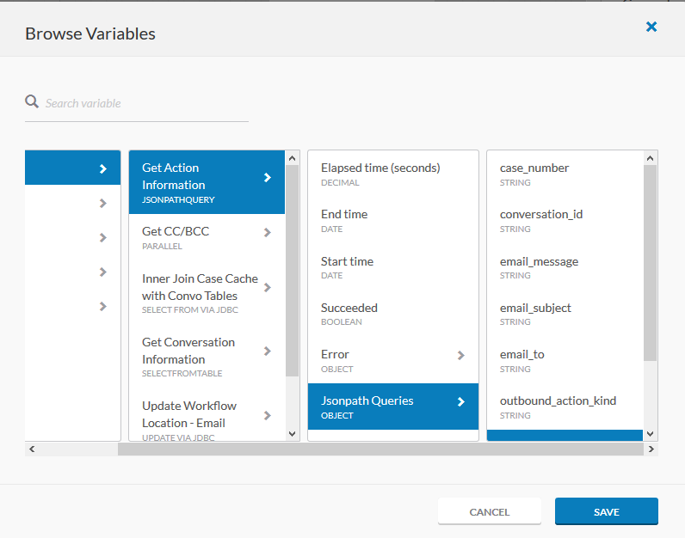
Variable References
Accessed via the Function Icon
Allows you to “reference” a variable/output/object from another part of the workflow
Can reference any variable defined in the workflow or a global variable
Can reference previous activities outputs
Cannot reference activities *after*
Cannot reference directly into a conditional

Slide 17
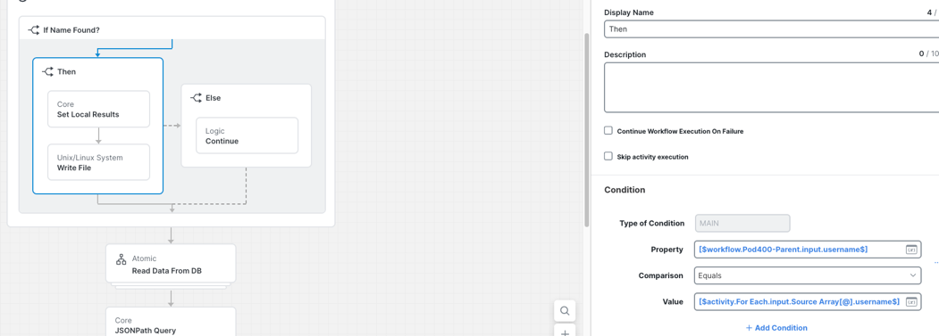
Conditionals
Allow you to make decisions in your orchestration
Same as “If then else” in other languages
Can have as many conditional branches as you wish
The Left Operand must be a reference
Operators will change based on the reference type
No “explicit else” but this is easy to do using a single Boolean variable equal to true

Slide 18
Automation Rules
Drive automation in the system
Types
Schedule – Repeatable based on time
Webhooks – Start workflows via POST
Incidents – Security events in XDR
Events – Some event in another system
Kafka (not currently in Automation)
AMQP (not currently in Automation)
Email
Task
Activated via Automation Rules
Most basic is Ad-Hoc

Slide 19
Rest API
Everything is API driven
Documentation - https://developer.cisco.com/docs/cisco-xdr/#!automation-api-guide
Automate APIs
Exchange APIs
Learning Labs - https://developer.cisco.com/learning/tracks/cisco-xdr/
Sample URL: https://automate.us.security.cisco.com/api/v1.1/workflows/start/<WORKFLOW_ID>

Slide 20
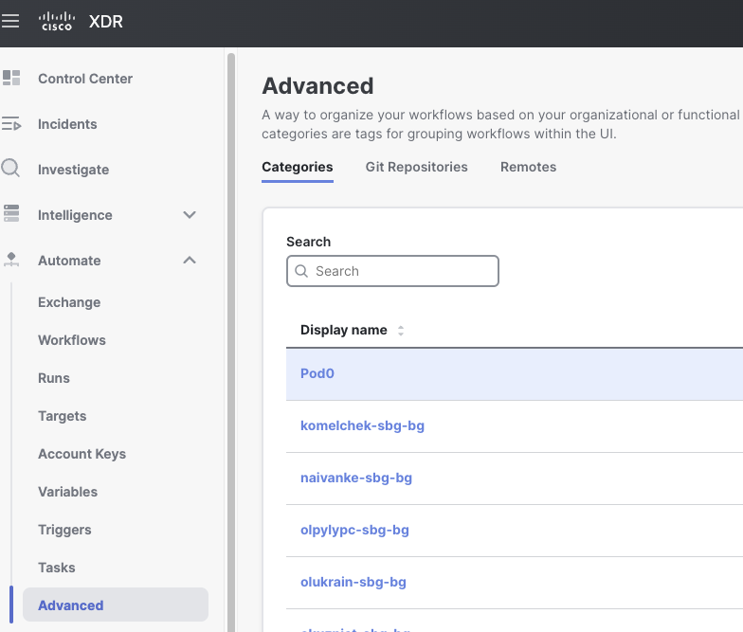
Advanced
Git – integration with repos for exporting/importing of code
Categories – Help organize content
Remote Configuration – Setup and deploy Automate Remotes

Slide 21
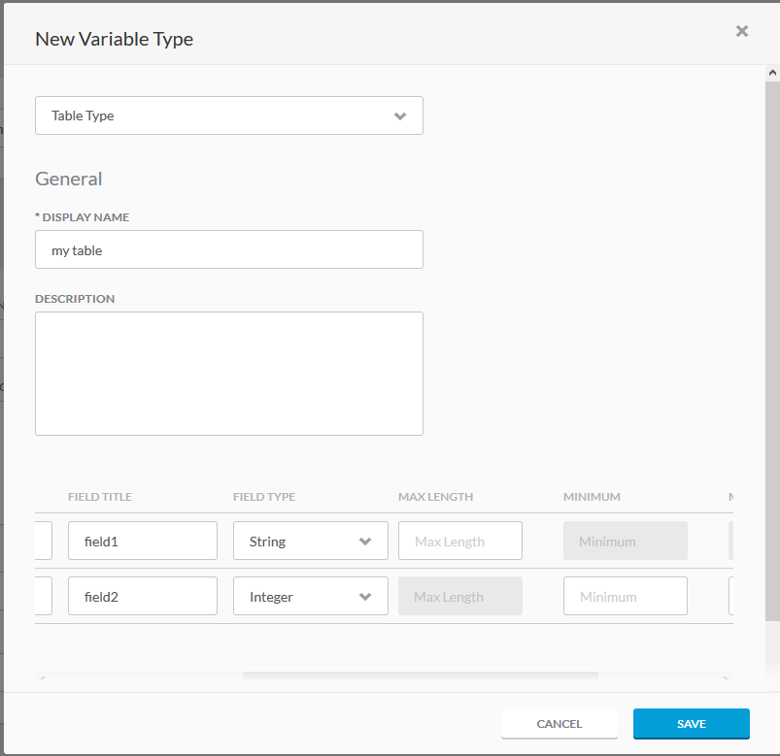
Tables
Complex Data Structure of Automation
Customizable 2-D Array Structure
Available locally or globally
Become own data type when created
When creating variable…
Click “Add New” for data type
Select “Table Type”
Input Display Name
Build table columns
Columns…
Can be required or not
Contain a field name and field title(what is seen in UI)
Types can be any primitive types
Additional parameters available

Slide 22
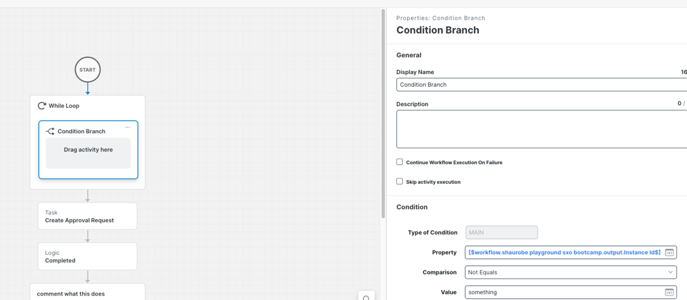
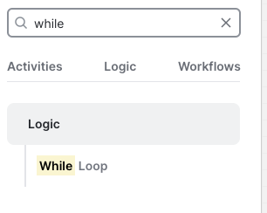
Loops - While
Standard “While” loop
Executes until a condition is reached
Supports AND/OR and more complex conditions
Any type can be used
Cannot reference directly inside loop as no guarantee it would run
Max executions as defined in global settings

Slide 23
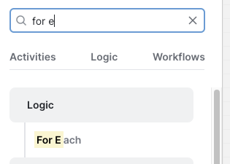
Loops – For Each
For Each loop
Executes “For Each” row in a table
Takes in a “source array” which is a table structure
When accessing properties inside must reference loop structure first
Max executions as defined in global settings

Slide 24
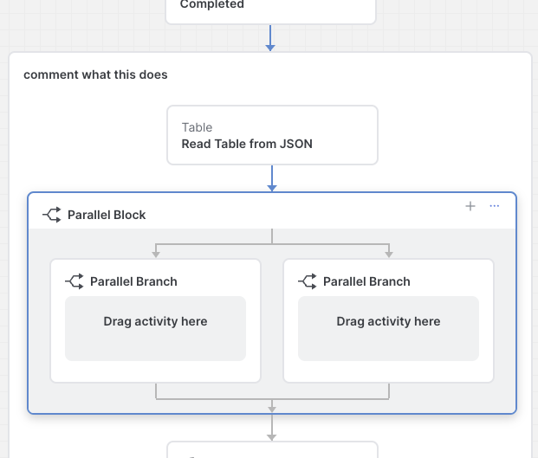
Parallel, Start Points, Group Blocks
Parallel
Allows concurrent thread-safe executions
Entire block does not succeed or fail until all sub blocks complete
Start Point
Allows user to define a separate start point other than “start of workflow”
Allows for small coding/testing of smaller blocks
Group
Allows user to put blocks of code together
Allows for easier copying, moving, organization of code
Does not affect runtime at all, purely dev-time

Slide 25
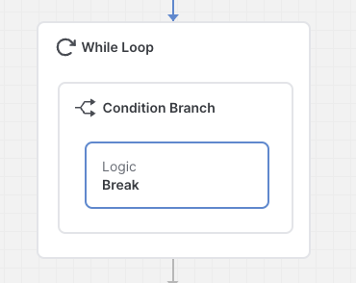
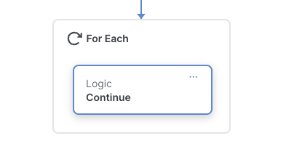
Continue and Break Points
Break - Ability to break loops
Continue – Ability to “skip” a loop iteration or just continue
Completed
Ability to break entire workflow
Complete can be succeeded or failed

Slide 26
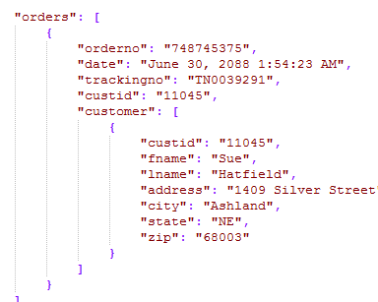
JavaScript Object Notation (JSON)
A lightweight data-interchange format
Defined for ease of human and machine understanding
What you will see used in most REST APIs
Automation will return this as message bodies from REST APIs
Automation allows you to parse JSON with ease via the JSON PATH query language
Two activities of value:
JSON Path Query: Reads singular data from JSON
Read Table from JSON: Reads Arrays from JSON into XDR Automation Tables

Slide 27
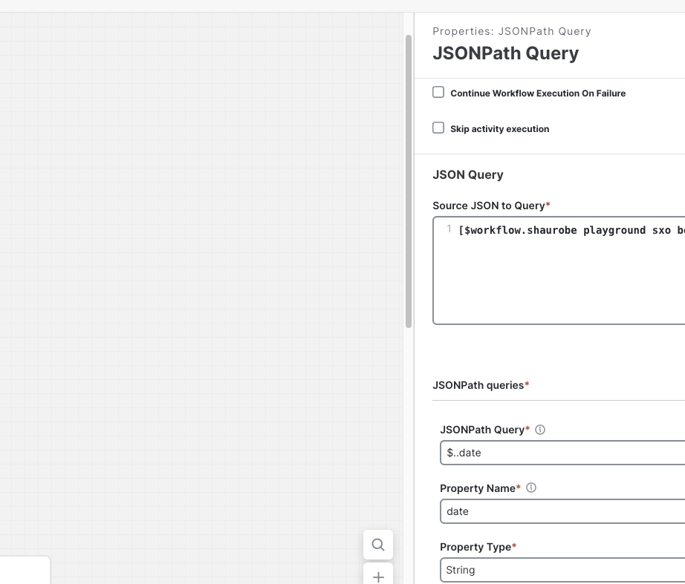
JSON Path Query
Query language used to parse JSON
JSON in Automation is a pure string, unlike in Python where it is normally a dictionary
Can parse from JSON single items or Arrays
Original Implementation
Automation uses Jayway implementation

Slide 28
JSON Path Examples
$..greeting
Wildcard search for all greeting. Returns “hello”
$.who
Returns the direct path starting at the root or “$.”. Returns “world”
$.world
Incorrect JSONPath as we query for the field, not the value. Returns nothing
$.students[*]
Returns all values from the students array. Returns both “Secure” and “X” student records
$.students[?(@.age>20)]
Returns only those records where Age is greater than 20. Returns the record for “Secure” student
{
"greeting": "hello",
"who": "world",
"students": [
{
"name": "Secure",
"age": 38
},
{
"name": "X",
"age": 15
}
]
}

Slide 29
Basic Workflow Lab – See Lab Guide

Slide 30
Workflow Best Practices and Troubleshooting

Slide 31
Let’s Gather Some Data
Before you ever start to write a workflow, you must consider a few things…
What will my data look like? JSON? XML? Text?
How does that data transform or need to transform?
What Targets will I need? HTTP endpoints, Terminal endpoints, Databases, etc
What access and credentials for those targets do I need?
Will I want to run this workflow on a schedule or via some triggering mechanism?
Can I draw out the end to end “general” flow before I start dragging and dropping?
Cisco Live Presentation – How I saved a bundle by switching to Automation
Powerpoint
Recordings

Slide 32
Self Documentation
Use the display name of an activity or sub-workflow to describe what it does
Make your workflows easy to understand and read. Using the same name as the default name does not tell anyone what your workflow does
Make your naming conventions consistent and not “random”
Write “Pseudo Code” into your logical blocks
Make positive use of the description fields

Slide 33
Importing and Exporting
Make sure if you are using atomics, all atomics are imported before you import workflows that use them
If your workflow makes use of targets that do not exist, make sure you have the credentials and information as Automation will prompt you to input them on import
It is your job as the importer to *know* all the pre-requisites and have them ready
The exporter should try to do some form of documentation to help understand the pre-requisites as well. In this case, commit comments are valuable as well as modifying the readmes on your git

Slide 34
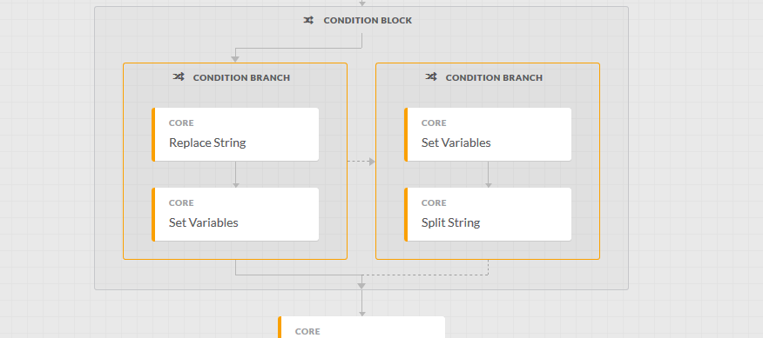
Poor Workflow…

Slide 35
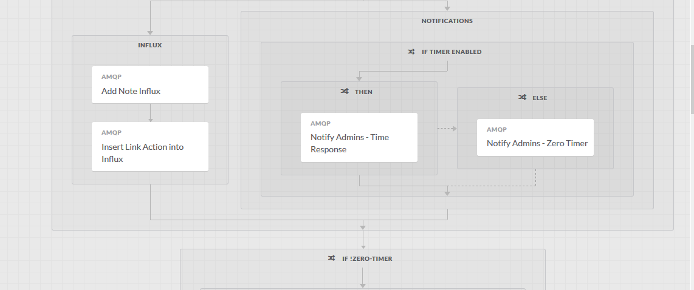
Great Workflow!

Slide 36
Work Smarter…. Not Harder
Parallelism – Make use of multiple threads, either via parallel blocks or asynchronous processing whenever you can. This will speed up execution time
Attempt to follow a pattern of “Read Data” -> “Mutate Data” -> “Write Data”
Whiteboard/Pen/paper – Write out your designs and workflow ideas, will make actual construction easier!
Understand your Data Flow

Slide 37
Variable Usage
Global variables can be accessed by any object. They are best for…
Configurations
Semi-static settings
Things that are not going to be referenced “aggressively”
Local Variables are only available to the workflow they are defined in and best for most everything else
True long-term storage or multi-access storage would still be best in an actual DB (mysql, MS SQL, oracle, mongo, etc)
Side note for Statics: Useful if you need a workflow local DB or storage

Slide 38
Target Usage
Try to re-use if possible
If you want a workflow to execute against multiple targets at once, use a target group
Target groups can be filtered as needed
If you make workflows that could be done against many targets, you can set them to pick the target on workflow start. This helps make your workflow more viable in many situations

Slide 39
Atomic Authoring
Make sure to keep workflow small and it should do 1, maybe 2 things
Set targets at start of workflow if possible
If you are doing more than a couple things, then make it a sub workflow and not an atomic
Put solid descriptions into your workflow and variables so others can easily use it

Slide 40
Naming Conventions
No current “mandated” naming convention for variables, activities, workflows, etc
In the interim it is suggested that you follow the self documentation guidance and do the best to make your workflows easier to understand and read
The key goal of the workflow author is to make sure that those that come after them to work on the workflows can pick right up where the original author left off

Slide 41
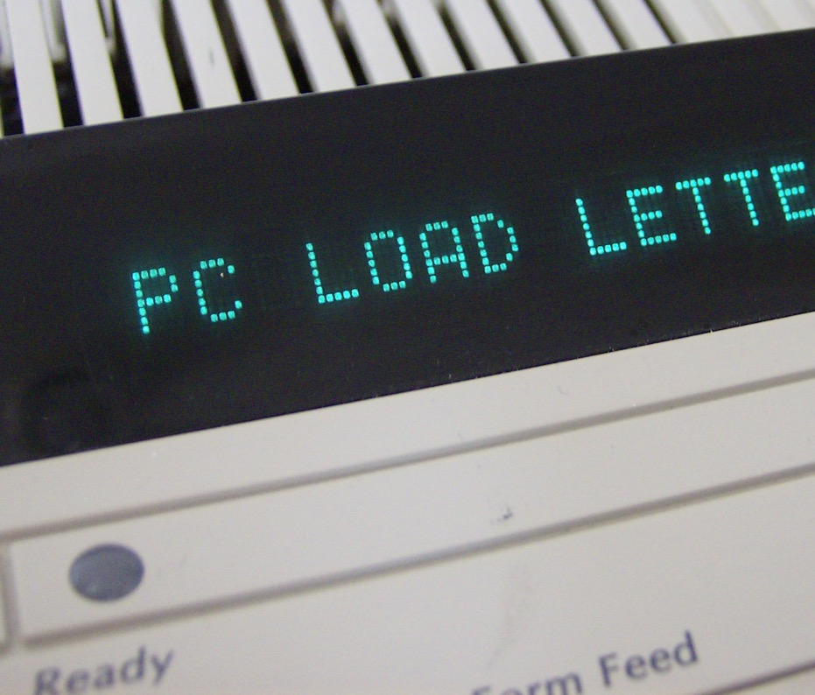
So you’ve seen an error…
Where do I start?
Can you replicate it again?
What error did you get?
What do I need to troubleshoot?
An error…. In software you say?
Expect it WILL happen
Expect to do some good troubleshooting
Understanding the workflow and data flow is key!

Slide 42
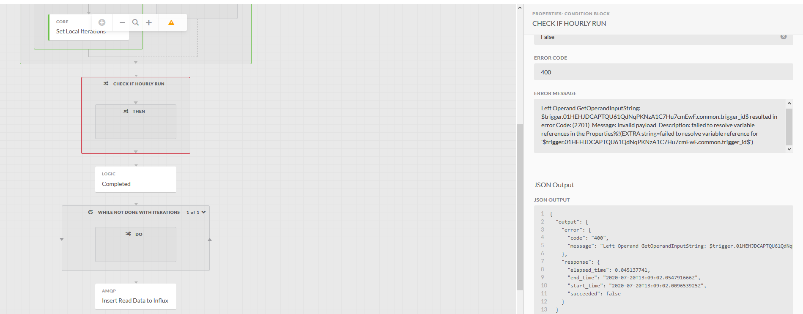
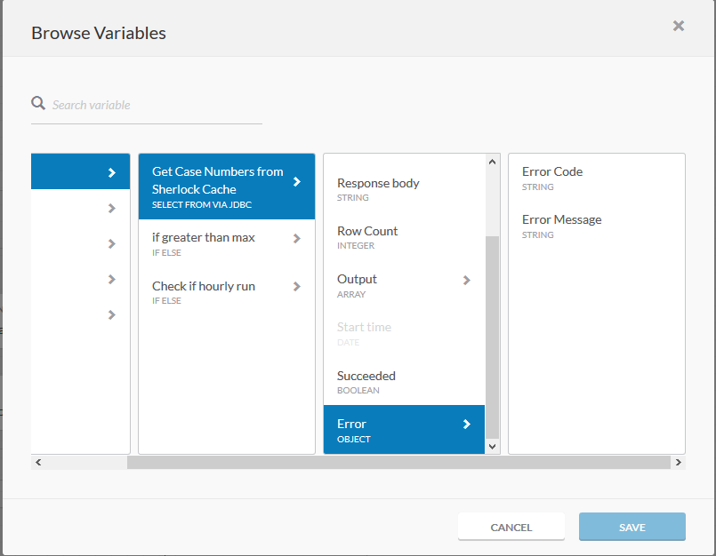
Errors
Every activity or workflow has an Error object which includes an error message and code
You can reference those in workflows to do automated triage in a workflow
When a workflow errors, you should check on the run of that workflow and refer to its error message to start your troubleshooting

Slide 43
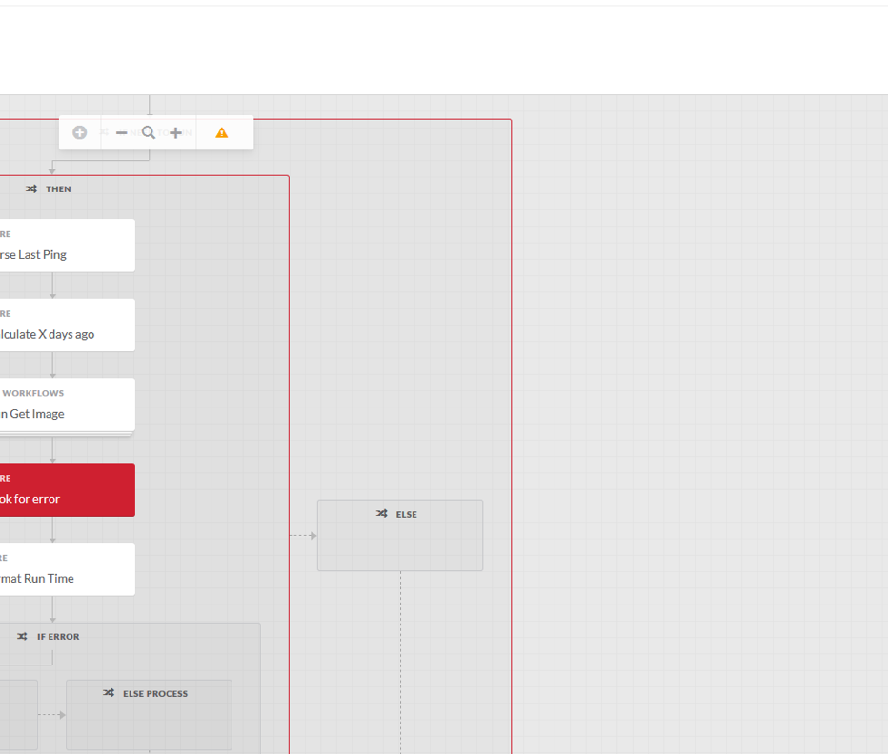
Common Errors
Connectivity issues from adapter to target
Incorrect variable reference mapping
Data incorrect at time of conditional
General Infrastructure Issues – Requires TAC and SaaS team engagement
When seeing workflow errors, look at the ERROR CODE and ERROR MESSAGE for your activity

Slide 44
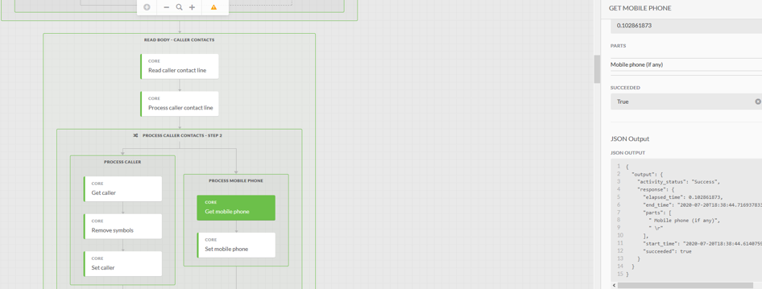
Tracing the Workflow
After finding an error, you need to start a trace of it
Begin with where the workflow failed and begin to trace the workflow and data back
It is important to understand “what” the data looks like at the time you are processing it
Is it JSON? Is it XML? Text? What was the workflow doing?
You must understand the overall flow!

Slide 45
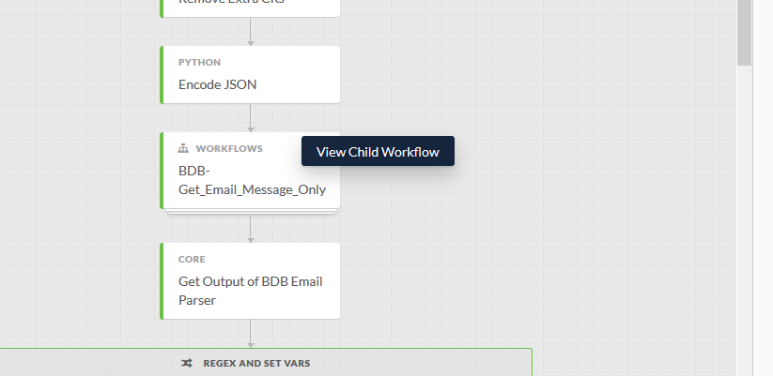
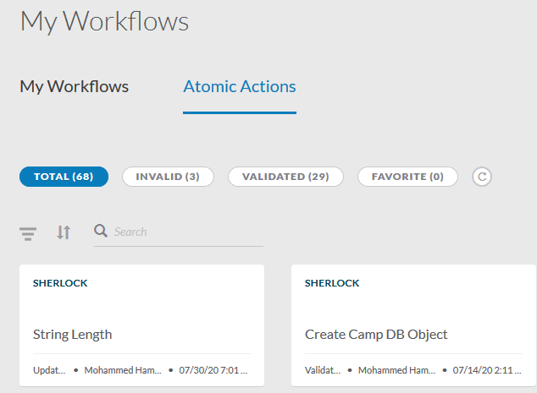
Troubleshooting Sub-Components
You must know when a workflow calls another workflow or atomic
Those activities are the 3-D/multi-layer blocks. They will be labeled “Workflows” or “Atomics”. Anything else is an out of the box activity built into an adapter
You can drill into Sub Workflows by clicking on the drop down on top right of them and clicking “View Child Workflow”
Atomics are found in the workflows section under Atomic Actions
You should look at inputs and outputs of these sub workflows to understand data flow
Much of the time you will have to “drill down” to the lowest level where there is only activities

Slide 46
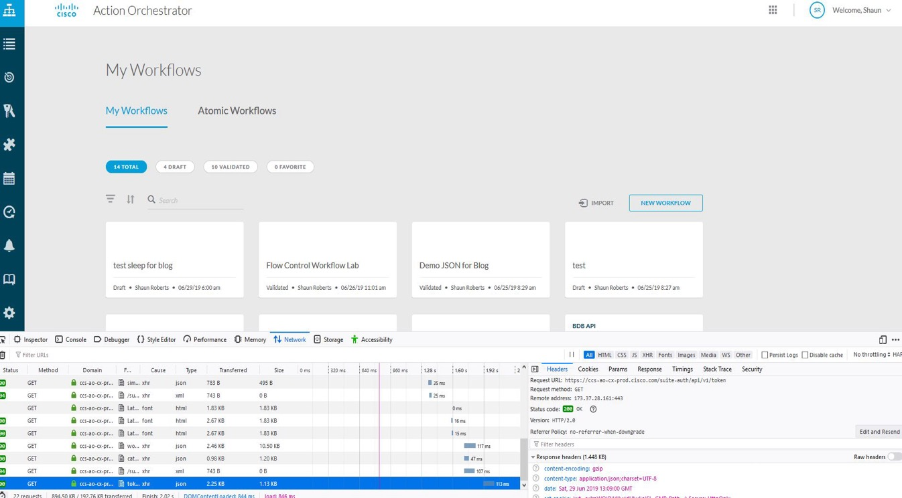
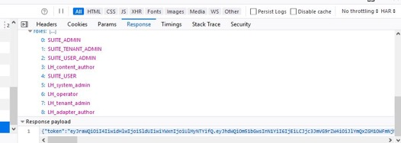
Troubleshooting on the UI
Everything is API Driven! 0% client logic
Web Developer
On your browser, select Web Developer
Select Network Pane
Refresh Browser
Use Web Developer to review API calls and returns
Verify user has access to components
Verify API is returning correct data
When in doubt, refresh your browser!

Slide 47
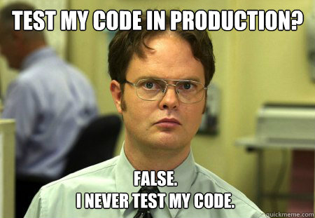
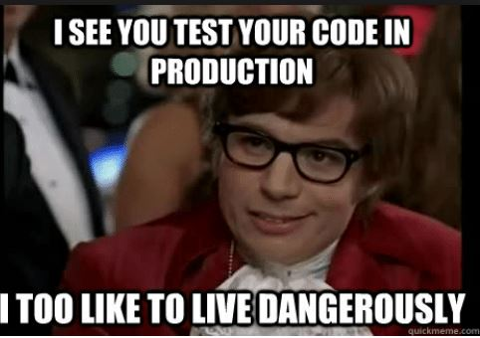
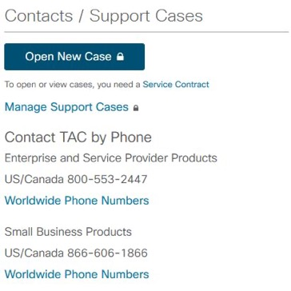
But what about bad code…
Users can write bad code… or inefficient code
Knowing how the data flows is key
Understand how to read a workflow
There is almost always multiple ways to come to a solution
Follow the best practices from the previous section to help
Assume new end users will not follow those best practices!
Workflow does not do what I want it to….
Run workflow and verify data flow
Verify data inputs and outputs
Verify runtime is what you expect from dev time
When in Doubt… Contact TAC! – Worldwide Support

Slide 48
Resources

Slide 49
XDR Automation Resources
XDR Automation Documentation https://docs.xdr.security.cisco.com/Content/Automate/about-automation.htm
XDR Automation API https://developer.cisco.com/docs/cisco-xdr/#!automation-api-guide

Slide 50
Complete Your Session Evaluations
Complete a minimum of 4 session surveys and the Overall Event Survey to be entered in a drawing to win 1 of 5 full conference passes to Cisco Live 2026.
Earn 100 points per survey completed and compete on the Cisco Live Challenge leaderboard.
Level up and earn exclusive prizes!
Complete your surveys in the Cisco Live mobile app.

Slide 51
Continue your education
Visit the Cisco Showcase for related demos
Book your one-on-one Meet the Engineer meeting
Attend the interactive education with DevNet, Capture the Flag, and Walk-in Labs
Visit the On-Demand Library for more sessions at www.CiscoLive.com/ on-demand
Contact me at: Insert preferred comms method

Slide 52
Thank you

Slide 53
Cisco

